Slide 1
Spinnaker Analytics Topic: Predicting Company Bankruptcies
Kirtan Patel
April 2026

Slide 2
AGENDA
Introduction
Project objective
Overview of dataset
Data Preprocessing
Exploratory Data Analysis(EDA)
Model Implementation
Model Comparison
Feature Importance
Conclusion

Slide 3
Introduction
This project focuses on predicting corporate bankruptcy using a financial dataset.
The dataset contains 6819 companies and 96 financial features, including profitability, liquidity, and debt ratios.
The main objective is to build a machine learning model to accurately classify companies as bankrupt or non-bankrupt.
Data preprocessing techniques were applied to handle class imbalance, remove redundant features, and scale the data.
Feature selection methods such as variance thresholding and correlation analysis were used to improve model efficiency.
Multiple machine learning models were implemented and compared for performance.
The project demonstrates how data-driven approaches can help identify financially distressed companies and support better decision-making.

Slide 4
Project Objective
To build a machine learning model that accurately predicts whether a company will go bankrupt or not.
To analyze financial indicators such as profitability, liquidity, and leverage to identify key risk factors.
To handle class imbalance using techniques like SMOTE to improve prediction of minority (bankrupt) cases.
To perform feature selection and preprocessing to enhance model efficiency and reduce redundancy.
To compare multiple machine learning models and select the best-performing one.
To optimize model performance using evaluation metrics such as recall, precision, and F1-score.
To develop a reliable system that helps in early detection of financially distressed companies.

Slide 5
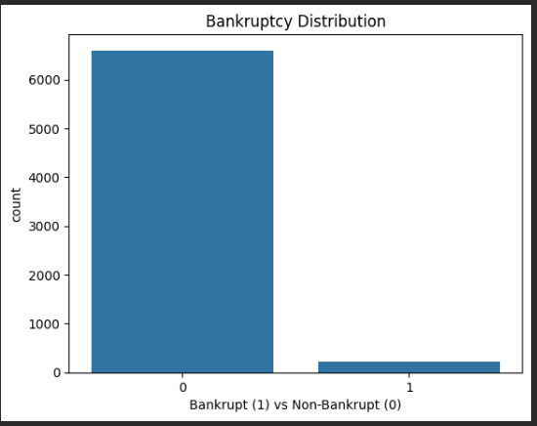
Overview Of Dataset
The dataset contains 6819 observations and 96 features, representing financial information of companies.
It includes various financial ratios such as profitability, liquidity, leverage, and efficiency indicators.
The target variable ‘Bankrupt?’ is binary, where 1 indicates bankrupt and 0 indicates non-bankrupt.
The dataset is highly imbalanced, with a significantly higher number of non-bankrupt companies.
Most features are continuous numerical variables, with varying scales and distributions.
The dataset shows high skewness and presence of outliers, common in financial data.
Several features are highly correlated, indicating redundancy and the need for feature selection.
The dataset does not contain categorical variables, making it suitable for direct use in machine learning models after preprocessing.

Slide 6
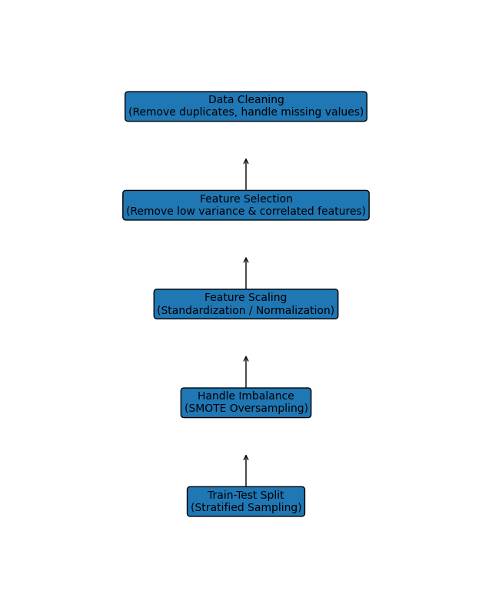
Data Preprocessing
Checked and handled missing values to ensure data quality and consistency.
Removed low-variance features that do not contribute meaningful information to the model.
Eliminated highly correlated features to reduce redundancy and multicollinearity.
Applied feature scaling (Standardization) to handle differences in feature magnitudes.
Addressed class imbalance using SMOTE (Synthetic Minority Oversampling Technique).
Split the dataset into training and testing sets using stratified sampling to maintain class distribution.
Performed feature selection to improve model performance and reduce complexity.
Prepared the dataset for machine learning models by ensuring it is clean, balanced, and optimized.

Slide 7
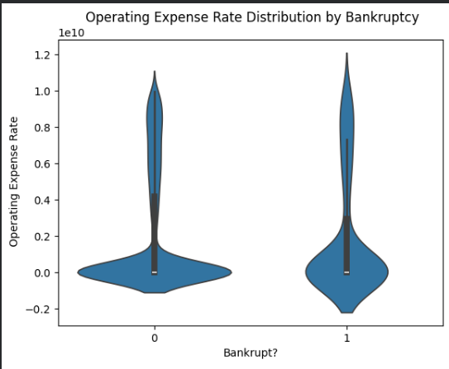
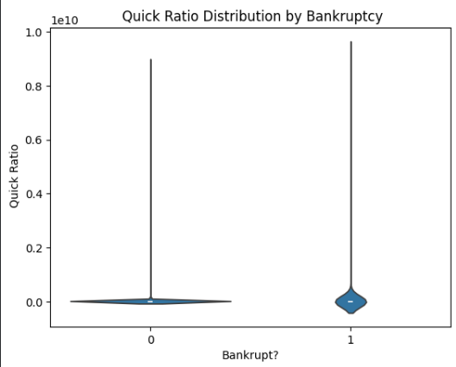
Exploratory Data Analysis(EDA)
Performed initial data analysis to understand the structure, distribution, and relationships within the dataset.
Identified that the dataset is highly imbalanced, with significantly fewer bankrupt companies.
Analyzed feature distributions and found skewness and presence of outliers in many financial variables.
Used correlation heatmap to detect highly correlated features and reduce redundancy.
Visualized data using plots such as countplot, heatmap, violin plots, and pairplots.
Observed that many features show overlapping patterns between classes, indicating complex relationships.
Identified important features influencing bankruptcy using feature importance techniques.
Insights from EDA helped guide feature selection, scaling, and model choice.

Slide 8
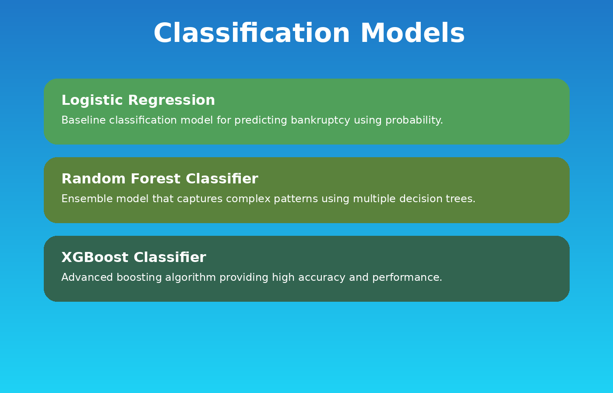
Model Implementation

Slide 9
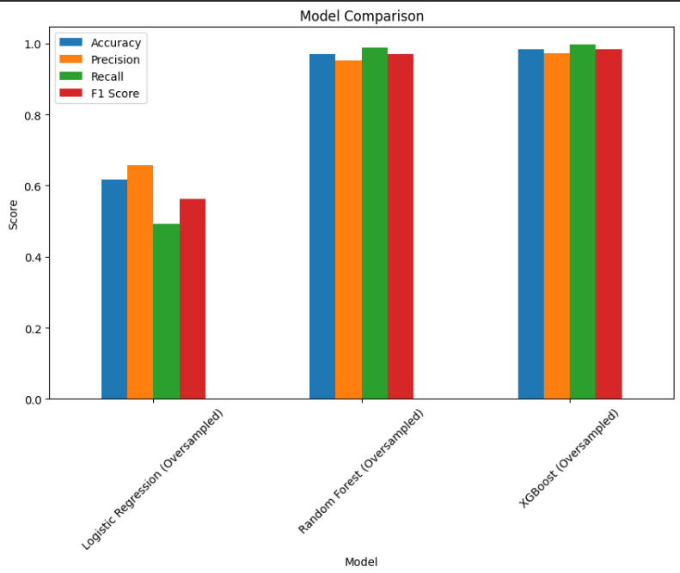
Model Comparison
Multiple classification models were implemented to evaluate performance on bankruptcy prediction.
Logistic Regression served as a baseline model but showed limited performance due to its assumption of linear relationships.
Random Forest Classifier improved performance by capturing non-linear patterns and reducing overfitting through ensemble learning.
XGBoost Classifier with oversampling outperformed all other models due to its advanced boosting technique and ability to handle complex feature interactions.
Model performance was evaluated using metrics such as accuracy, precision, recall, and F1-score.
Special focus was given to recall, as correctly identifying bankrupt companies is more critical.
XGBoost oversampling achieved the best balance between precision and recall, making it the most reliable model.

Slide 10
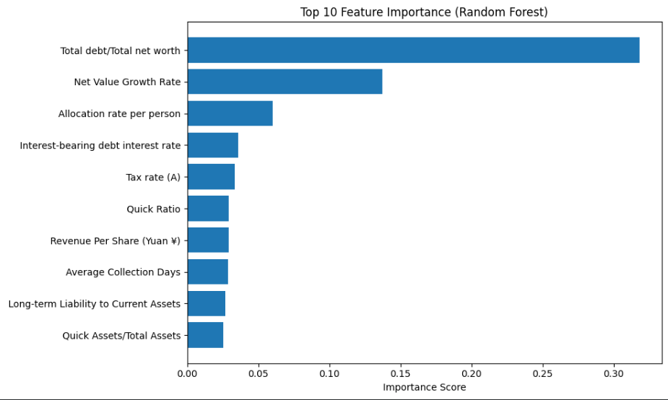
Feature Importance
Feature importance analysis was performed using the XGBoost model to identify the most influential variables in predicting bankruptcy.
It helps in understanding which financial indicators contribute most to the model’s decisions.
The top important features include key financial ratios related to profitability, liquidity, and debt management.
Features such as cash flow, total assets, debt ratio, and operating margins showed strong influence on bankruptcy prediction.
Many less important or redundant features were removed to improve model efficiency and reduce complexity.
Feature importance also improves model interpretability, making results easier to explain.

Slide 11
Conclusion
This project successfully developed a machine learning model to predict corporate bankruptcy using financial data.
The dataset was highly imbalanced, which was effectively handled using SMOTE oversampling.
Data preprocessing and feature selection helped improve model performance and reduce redundancy.
Multiple models were evaluated, including Logistic Regression and Random Forest.
XGBoost Classifier with oversampling outperformed all models, providing the best results in terms of recall and overall performance.
The model was able to capture complex patterns in financial data and improve prediction accuracy.
The results demonstrate that machine learning can be effectively used for early detection of financially distressed companies.

Slide 12
THANKYOU

